Slide 1


OBESITY MANAGEMENT MEDICATIONS: LINEE GUIDA
Dr. Matteo Monami
Careggi Teaching Hospital,
Firenze

Slide 2
Il Dr. M. Monami ha ricevuto speaking fees/grant da:
Boehringer
Lilly
Novonordisk
Biocomposites
Molteni
e da Società Scientifiche:
SICOB
IFSO
EASO
SIO
ESE

Slide 3
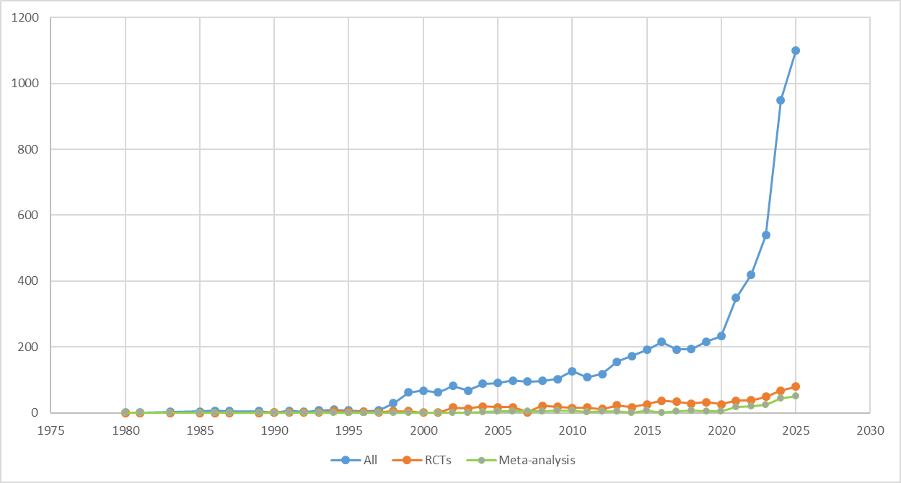
How to manage all this info?
Search string: (obesity or overweight) AND (orlistat OR naltrexone OR bupropion OR liraglutide OR semaglutide OR tirzepatide OR phentermine/topiramate)
Trials on OMM: 798 up to 24th, Oct 2025

Slide 4
Pyramid of scientific evidence: efficacy and safety based on RCT

Slide 5
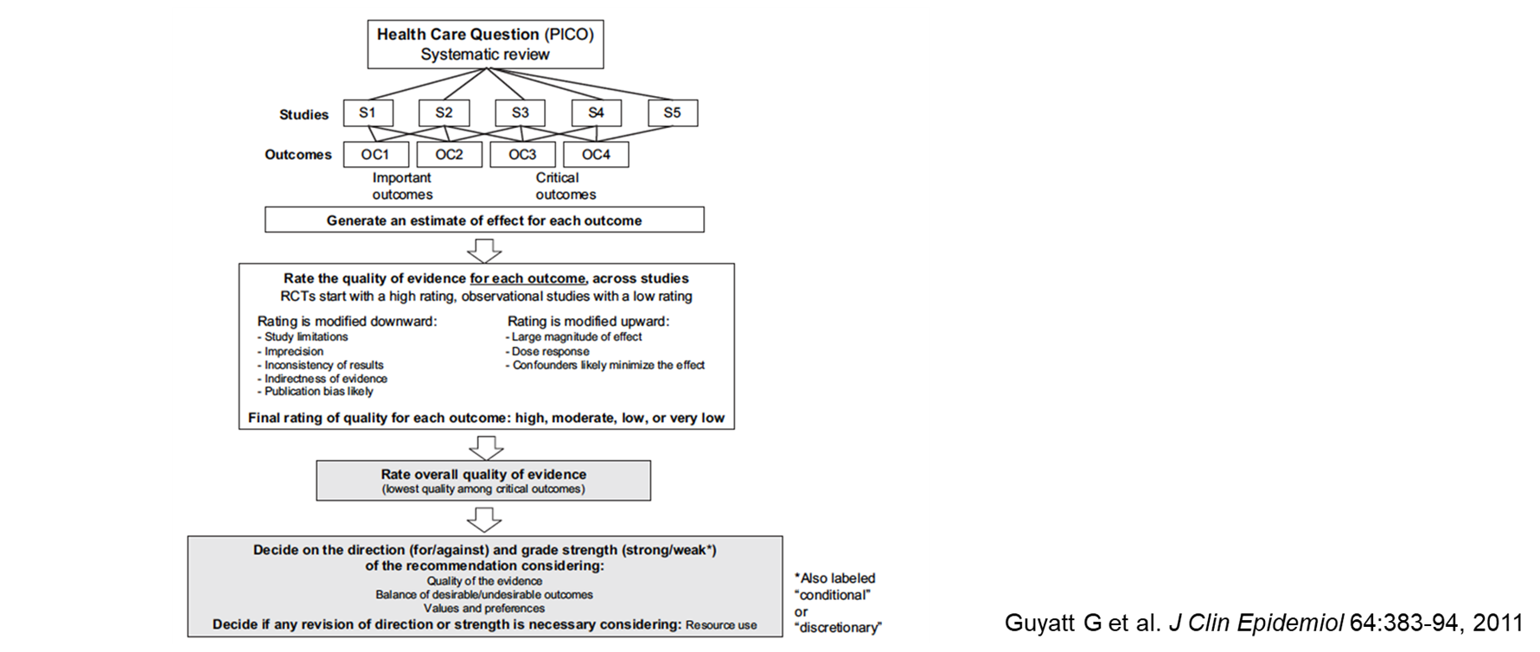
How to manage all this info?

Slide 6
How to manage all this info?
GRADE

Slide 7
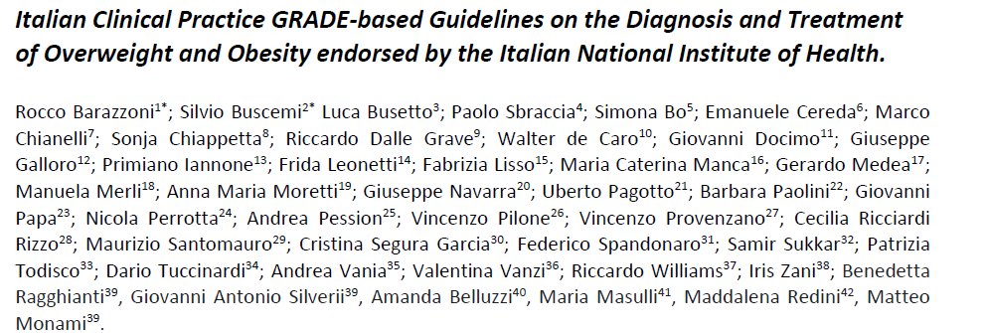
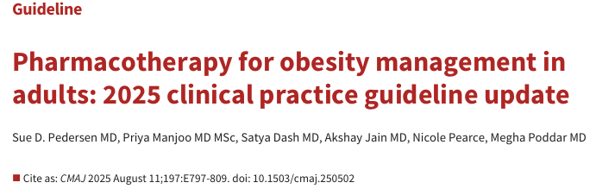
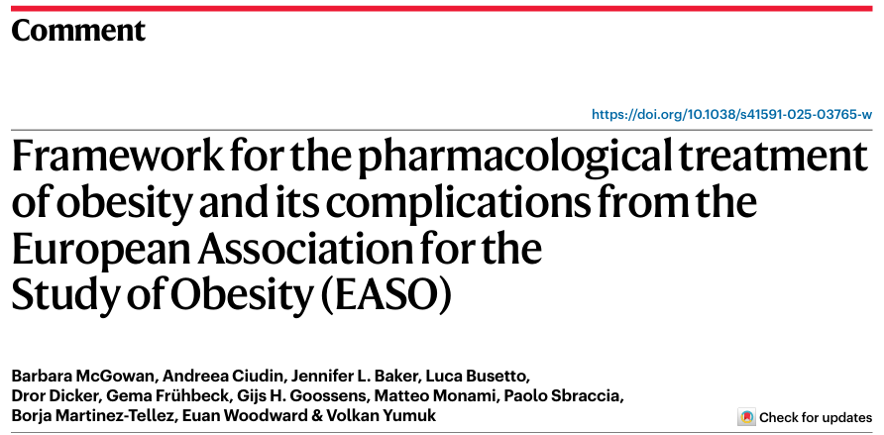
How to manage all this info?
SIO
EASO
Barazzoni R, et al., EWD, 2025; Manuscript submitted
McGowan B, et al., Nat Med, 2025; 3229–3232
Pedersen S, et al., CMAJ 2025; E797-809

Slide 8
How to manage all this info?
SIO
EASO
Barazzoni R, et al., EWD, 2025; Manuscript submitted
McGowan B, et al., Nat Med, 2025; 3229–3232
Pedersen S, et al., CMAJ 2025; E797-809

Slide 9
How to manage all this info?
SIO
EASO
Barazzoni R, et al., EWD, 2025; Manuscript submitted
McGowan B, et al., Nat Med, 2025; 3229–3232
Pedersen S, et al., CMAJ 2025; E797-809

Slide 10


Methods
Characteristics | Canadian | EASO | SIO
GRADE
Network Meta-analysis
Up to May 2025
ASCVD
Heart failure
Prediabetes/diabetes
MASH/MASLD
OSAS
OA
Dyslipidemia
Hypertension
Surgical options
Subjects with BMI>
Barazzoni R, et al., EWD, 2025; Manuscript submitted
McGowan B, et al., Nat Med, 2025; 3229–3232
Pedersen S, et al., CMAJ 2025; E797-809

Slide 11
Methods
Characteristics | Canadian | EASO | SIO
GRADE
Network Meta-analysis
Up to May 2025
RCT duration
ASCVD
Heart failure
Prediabetes/diabetes
MASH/MASLD
OSAS
OA
Hyperten./Dyslipid.
Surgical/Endos. options
Barazzoni R, et al., EWD, 2025; Manuscript submitted
McGowan B, et al., Nat Med, 2025; 3229–3232
Pedersen S, et al., CMAJ 2025; E797-809

Slide 12
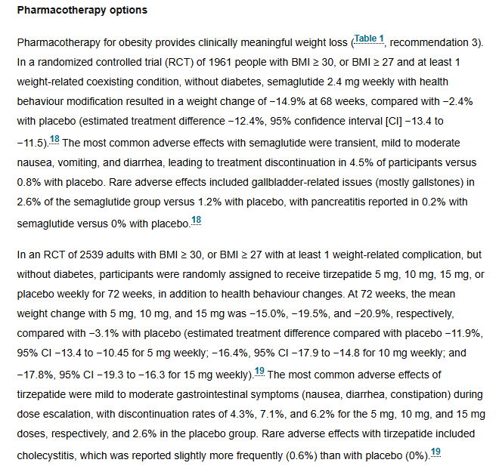
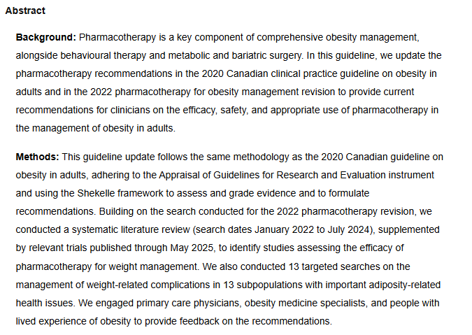
Body weight
Pedersen S, et al., CMAJ 2025; E797-809

Slide 13
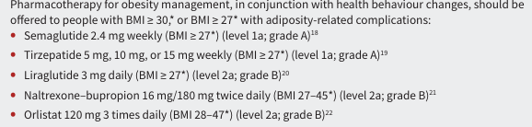
Body weight
Pedersen S, et al., CMAJ 2025; E797-809

Slide 14
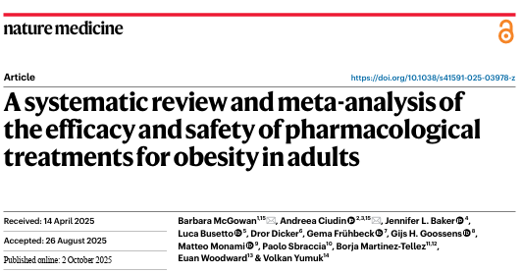
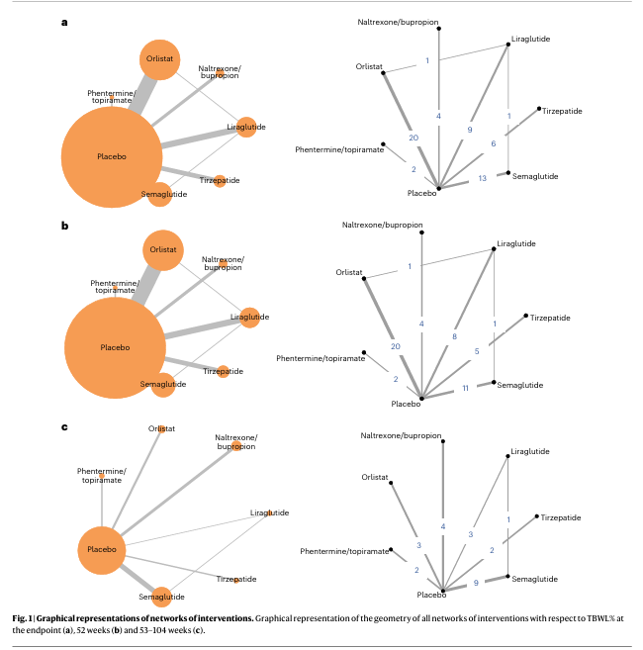
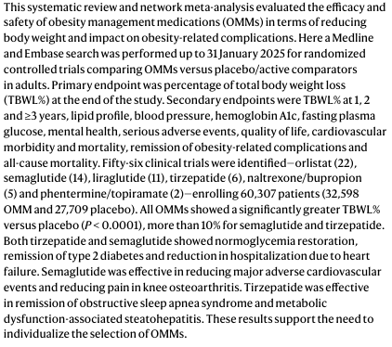
Body weight
McGowan B, et al., Nat Med, 2025; 3229–3232

Slide 15
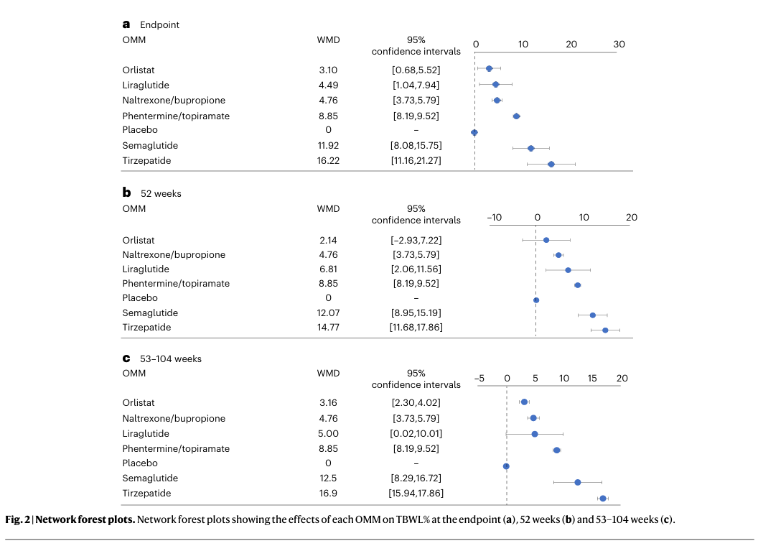
Body weight
McGowan B, et al., Nat Med, 2025; 3229–3232

Slide 16
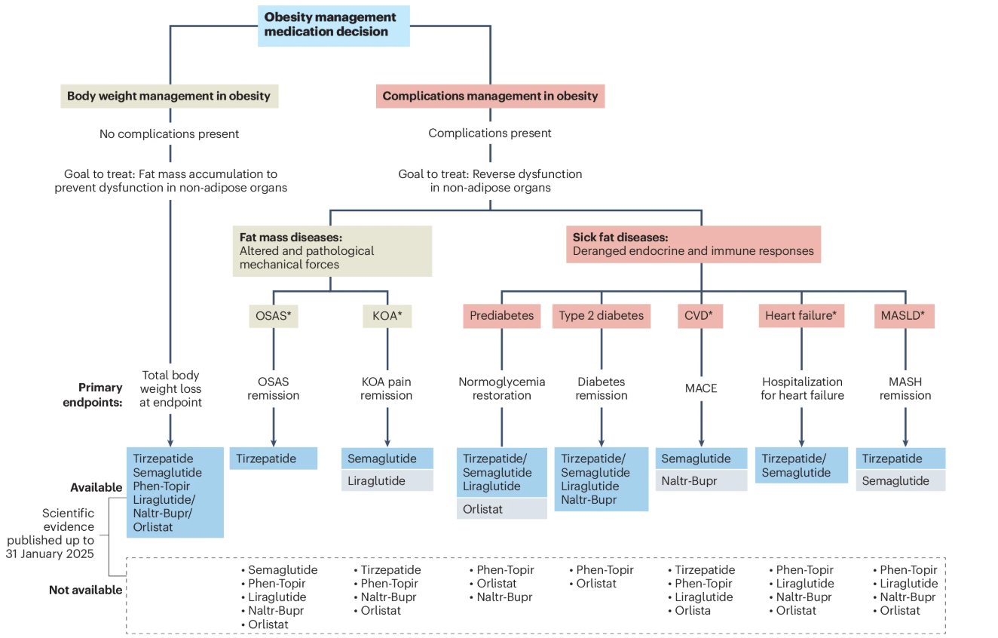
Body weight
McGowan B, et al., Nat Med, 2025; 3229–3232

Slide 17
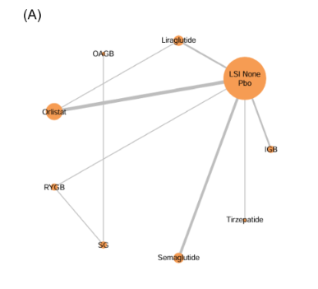
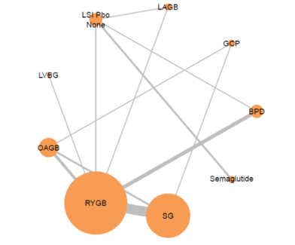
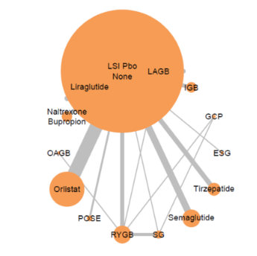
Class I obesity
Body weight
Class III obesity
Class II obesity
Barazzoni R, et al., EWD, 2025; Manuscript submitted

Slide 18
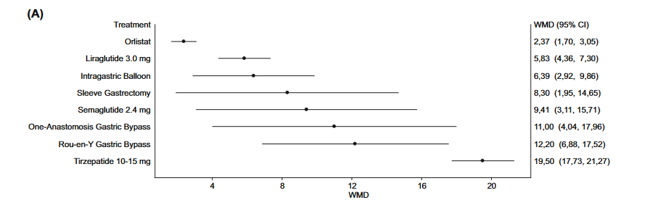
Body weight
Class I obesity
Barazzoni R, et al., EWD, 2025; Manuscript submitted

Slide 19
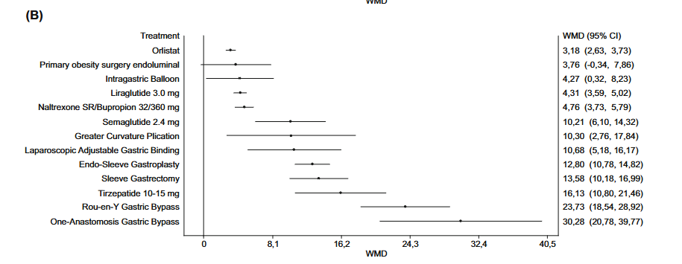
Body weight
Class II obesity
Barazzoni R, et al., EWD, 2025; Manuscript submitted

Slide 20
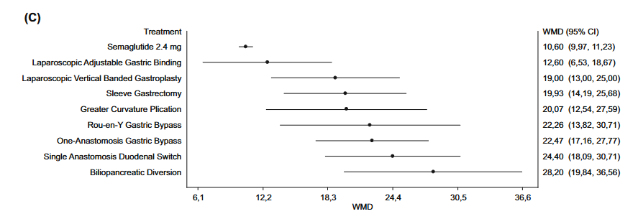
Body weight
Class III obesity
Barazzoni R, et al., EWD, 2025; Manuscript submitted

Slide 21
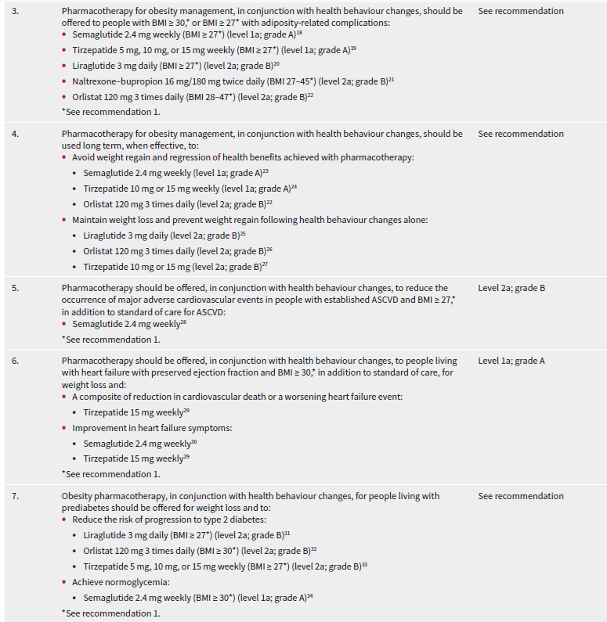
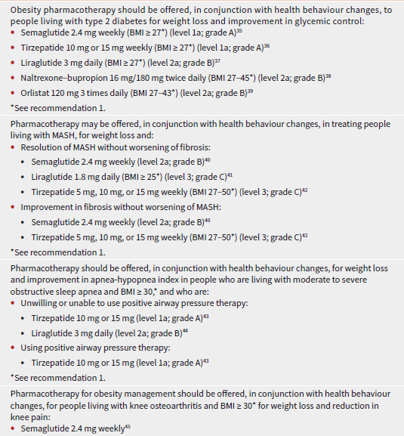
Pedersen S, et al., CMAJ 2025; E797-809

Slide 22
McGowan B, et al., Nat Med, 2025; 3229–3232

Slide 23

OMM across different Guidelines
Characteristics | Canadian | EASO | SIO
Cardiovascular disease | Semaglutide | Semaglutide Naltrexone/Bupropion | Semaglutide (Overweight and Class I)
Heart failure | Tirzepatide/Semaglutide | Tirzepatide/Semaglutide | Tirzepatide/Semaglutide (Class II)
Prediabetes | Lirag./Orlis./Tirzep./Semag. | Tirzepatide/Semaglutide Liraglutide | Lira/Orlistat (Class I) Semaglutide (Class II)
Type 2 diabetes | Semag./Tirzep./Lirag./NB/Orlis | Tirzepatide/Semaglutide Liraglutide/NB | Semaglutide (Class I) Tirze/Sema/Lira/NB (Class II)
MASH/MASLD | Semag./Tirzep./Lirag. | Tirzepatide Semaglutide | Tirzepatide (Class II)
Sleep apnea syndrome | Tirzep./Lirag. | Tirzepatide | Tirzepatide (Class II)
Knee osteoarthritis | Semaglutide | Semaglutide Liraglutide | Semaglutide (Class III)

